Slide 1
Quadratics
EQ – How can the parabola be transformed?
Year 10 Mathematics

Slide 2
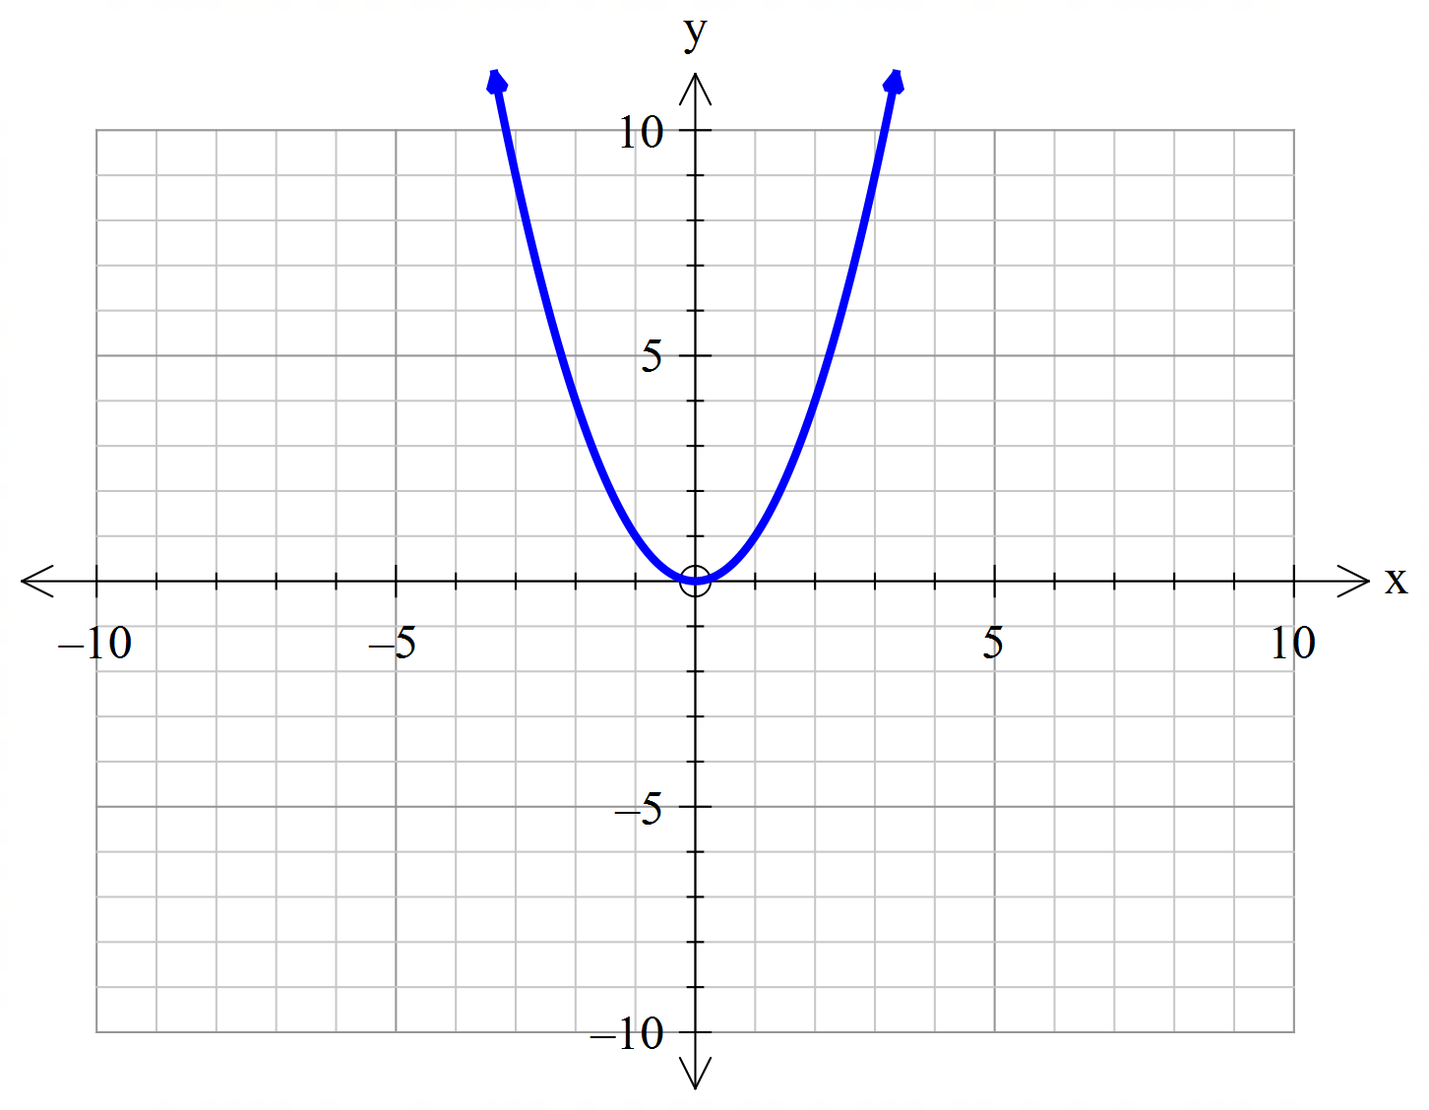
24
7
30
Topic: Quadratics
Date:
EQ – How can the parabola be transformed?
What is transformation?
Transformations in mathematics involves, reflection, translation, and dilation. These can be applied to parabolas
What is the simplest parabola?
The simplest parabola is $y=x^{2}$ and this is what will be transformed

Slide 3
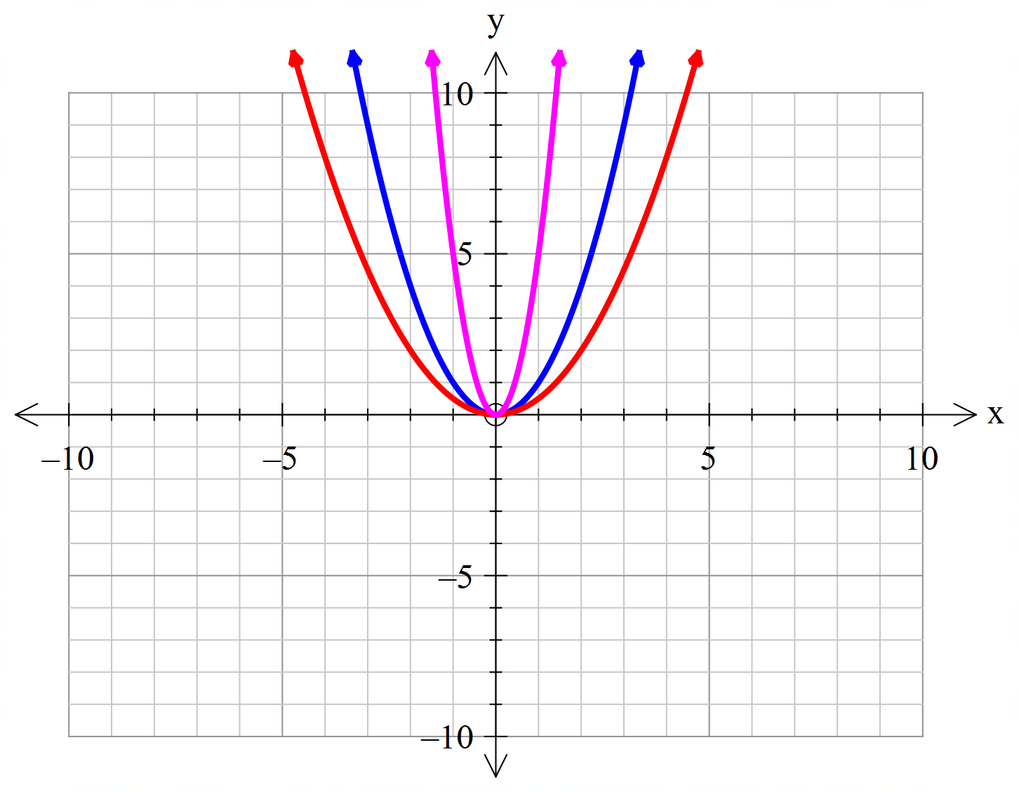
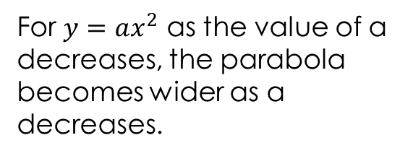
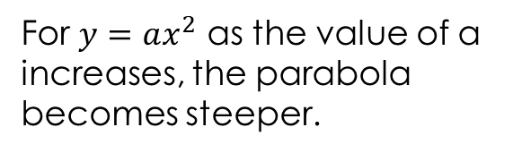



24
7
30
Topic: Quadratics
Date:
EQ – How can the parabola be transformed?
How do we dilate or reduce a parabola?
$$y=5x^{2}$$
For $y=ax^{2}$ as the value of a increases, the parabola becomes steeper.
$$y=x^{2}$$
$$y={\frac{1}{2}x}^{2}$$
For $y=ax^{2}$ as the value of a decreases, the parabola becomes wider as a decreases.

Slide 4
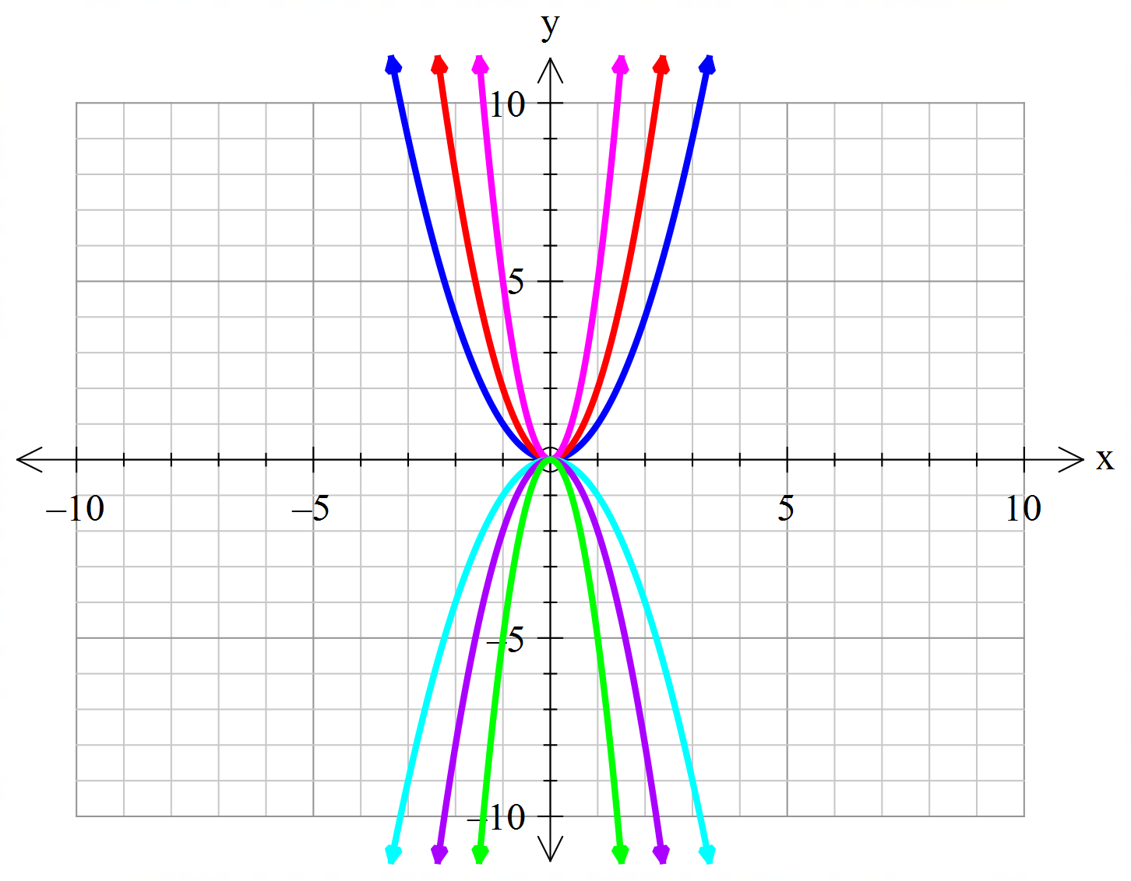



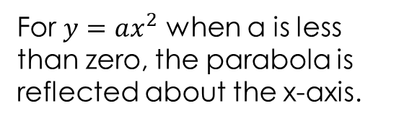


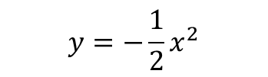
24
7
30
Topic: Quadratics
Date:
EQ – How can the parabola be transformed?
How do we reflect a parabola about the x-axis?
$$y=x^{2}$$
For $y=ax^{2}$ when a is less than zero, the parabola is reflected about the x-axis.
$$y={5x}^{2}$$
$$y={\frac{1}{2}x}^{2}$$
$$y={−x}^{2}$$
$$y={−5x}^{2}$$
$$y={−\frac{1}{2}x}^{2}$$

Slide 5
24
7
30
Topic: Quadratics
Date:
EQ – How can the parabola be transformed?
How do we reflect a parabola about the x-axis?
$$y=x^{2}$$
For $y=ax^{2}$ when a is less than zero, the parabola is reflected about the x-axis.
$$y={5x}^{2}$$
$$y={\frac{1}{2}x}^{2}$$
$$y={−x}^{2}$$
$$y={−5x}^{2}$$
$$y={−\frac{1}{2}x}^{2}$$

Slide 6
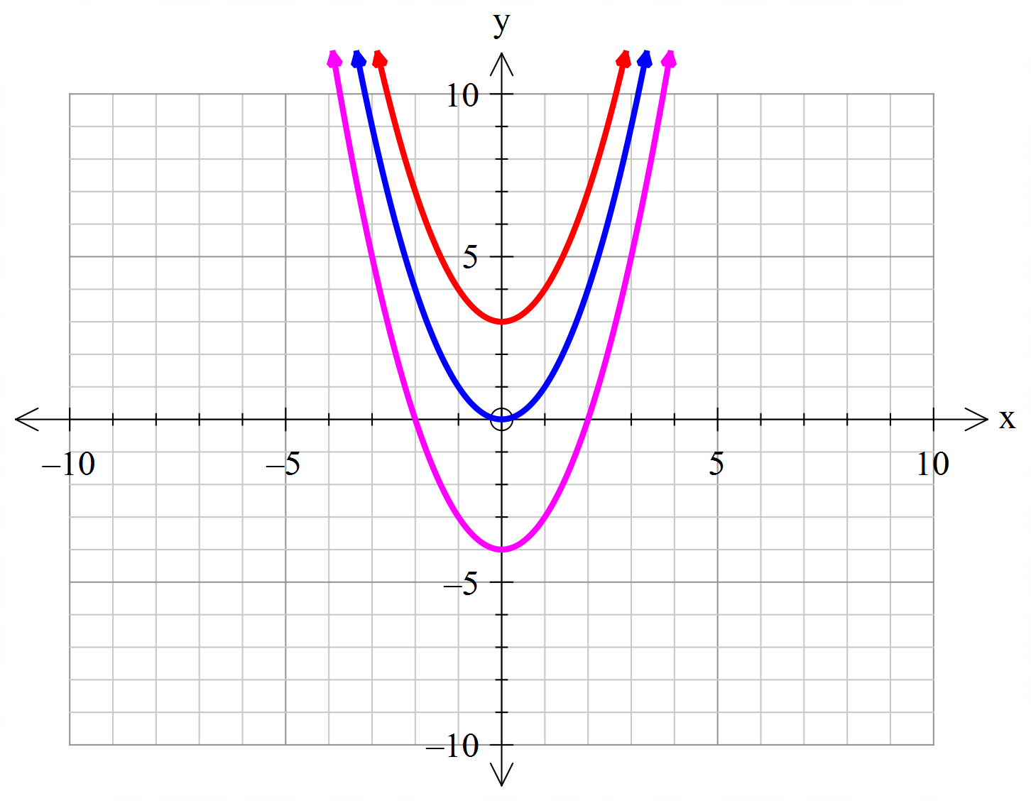


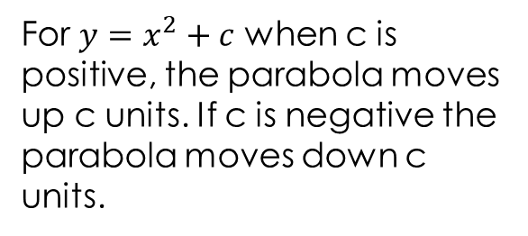

24
7
30
Topic: Quadratics
Date:
EQ – How can the parabola be transformed?
How do we move a parabola vertically?
$$y=x^{2}+3$$
For $y=x^{2}+c$ when c is positive, the parabola moves up c units. If c is negative the parabola moves down c units.
$$y=x^{2}$$
$$y=x^{2}−4$$

Slide 7
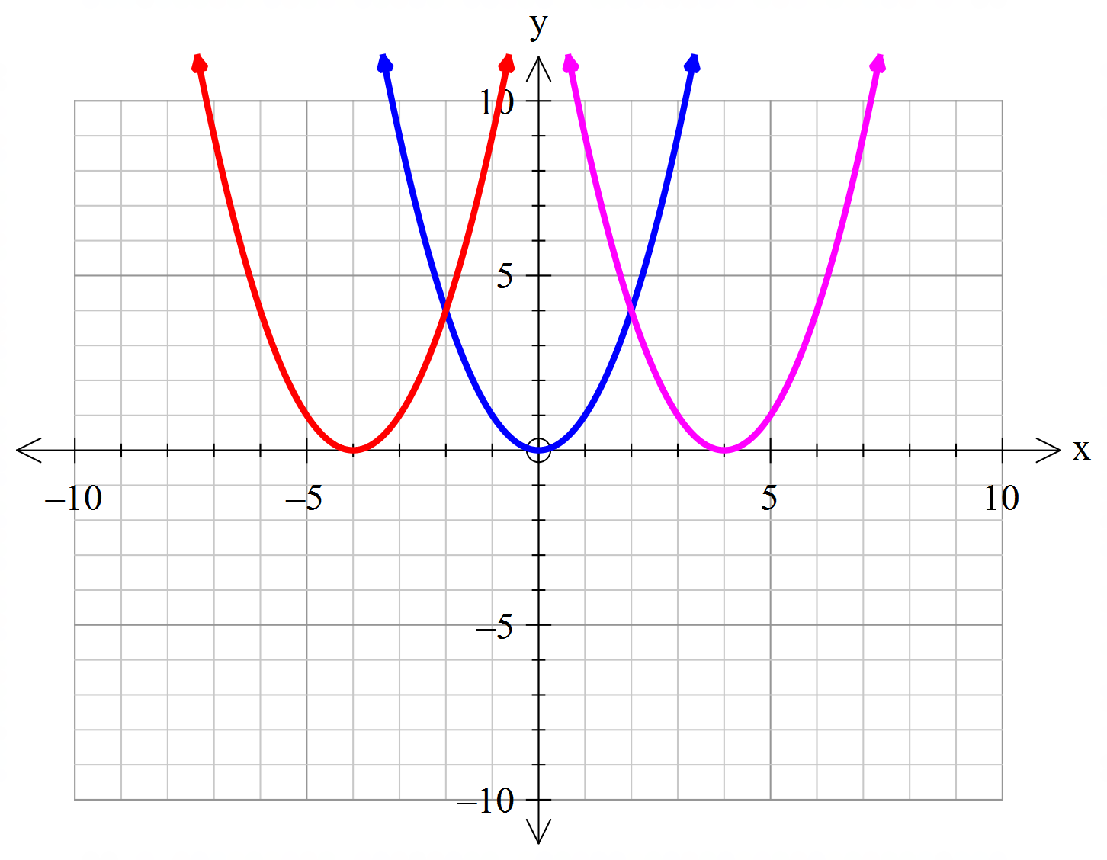


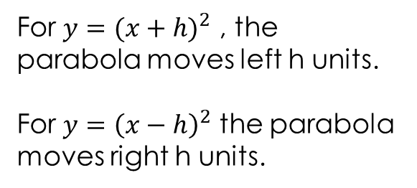

24
7
30
Topic: Quadratics
Date:
EQ – How can the parabola be transformed?
How do we move a parabola horizontally?
$$y={\left(x+4\right)}^{2}$$
$$y=x^{2}$$
For $y={(x+h)}^{2}$ , the parabola moves left h units.
For $y={\left(x−h\right)}^{2}$ the parabola moves right h units.
$$y={\left(x−4\right)}^{2}$$

Slide 8
24
7
30
Topic: Quadratics
Date:
EQ – How can the parabola be transformed?
How do we move a parabola horizontally?
$$y={\left(x+4\right)}^{2}$$
$$y=x^{2}$$
For $y={(x+h)}^{2}$ , the parabola moves left h units.
For $y={\left(x−h\right)}^{2}$ the parabola moves right h units.
$$y={\left(x−4\right)}^{2}$$

Slide 9


Slide 10
Task
Complete the Quadratics Transformation Worksheet

